Slide 1
Linear models for data science
A brief introduction
Brad Klingenberg, Director of Styling Algorithms at Stitch Fix
brad@stitchfix.com
Insight Data Science, Oct 2015

Slide 2
Linear models in data science
Goal: give a basic overview of linear modeling and some of its extensions

Slide 3
Linear models in data science
Goal: give a basic overview of linear modeling and some of its extensions
Secret goal: convince you to study linear models and to try simple things first

Slide 4
Linear regression? Really?
Wait... regression? That’s so 20th century!

Slide 5
Linear regression? Really?
Wait... regression? That’s so 20th century!
What about deep learning? What about AI? What about Big Data™?

Slide 6
Linear regression? Really?
Wait... regression? That’s so 20th century!
What about deep learning? What about AI? What about Big Data™?
There are a lot of exciting new tools. But in many problems simple models can take you a long way.

Slide 7
Linear regression? Really?
Wait... regression? That’s so 20th century!
What about deep learning? What about AI? What about Big Data™?
There are a lot of exciting new tools. But in many problems simple models can take you a long way.
Regression is the workhorse of applied statistics

Slide 8
Occam was right!
Simple models have many virtues

Slide 9
Occam was right!
Simple models have many virtues
In industry
Interpretability
for the developer and the user
Clear and confident understanding of what the model does
Communication to business partners

Slide 10
Occam was right!
Simple models have many virtues
In industry
Interpretability
for the developer and the user
Clear and confident understanding of what the model does
Communication to business partners
As a data scientist
Enables iteration: clarity on how to extend and improve
Computationally tractable
Often close to optimal in large or sparse problems

Slide 11
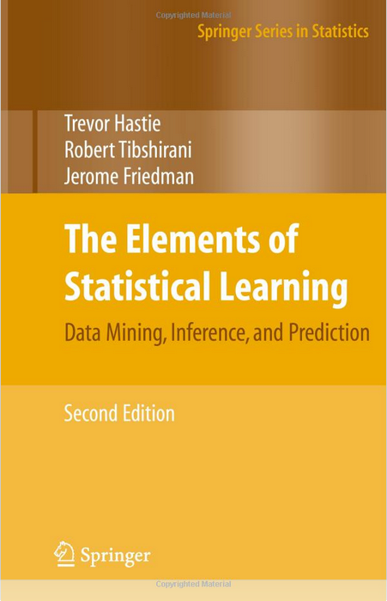
An excellent reference
Figures and examples liberally stolen from
[ESL]

Slide 12
Part I: Linear regression

Slide 13
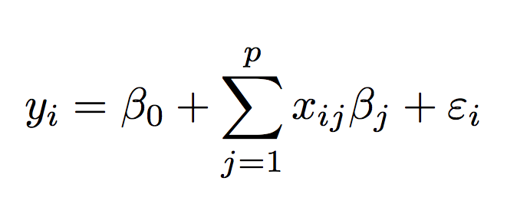
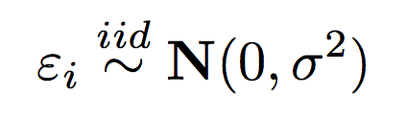
The basic model
We observe N numbers Y = (y_1, …, y_N) from a model
How can we predict Y from X?

Slide 14
The basic model
noise term
number of features
independence
assumption
noise level
response
global intercept
feature j of observation i
coefficient for feature j

Slide 15
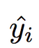
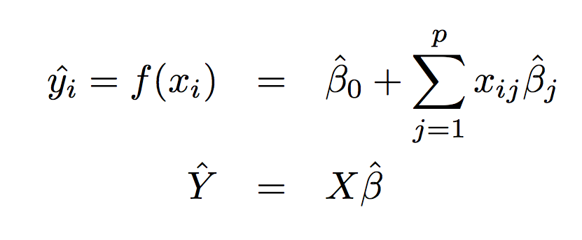
A linear predictor from observed data
is linear in the features
matrix representation

Slide 16
X: the data matrix
Rows are observations
N rows

Slide 17
X: the data matrix
Columns are features
p columns
also called
predictors
covariates
signals

Slide 18
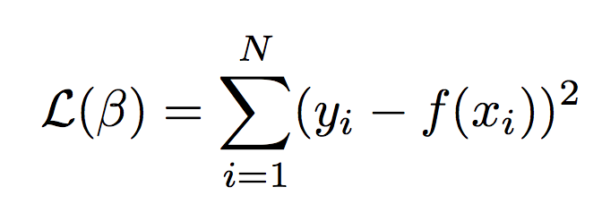
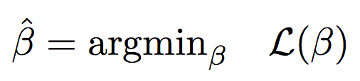
Choosing β
Minimize a loss function to find the β giving the “best fit”
Then

Slide 19
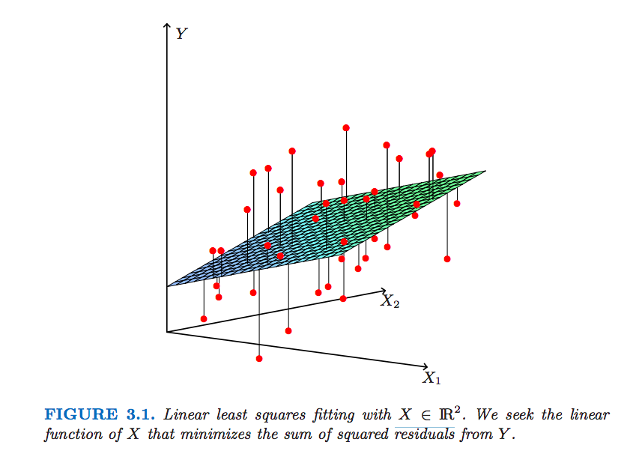
Choosing β
Minimize a loss function to find the β giving the “best fit”
[ESL]

Slide 20
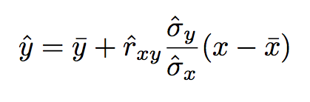
An analytical solution: univariate case
With squared-error loss the solution has a closed-form

Slide 21
An analytical solution: univariate case
“Regression to the mean”
adjustment for
scale of variables
distance of predictor from
its average
sample correlation

Slide 22
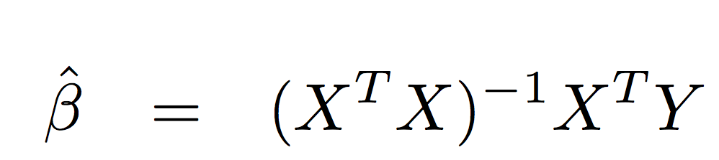
A general analytical solution
With squared-error loss the solution has a closed-form

Slide 23
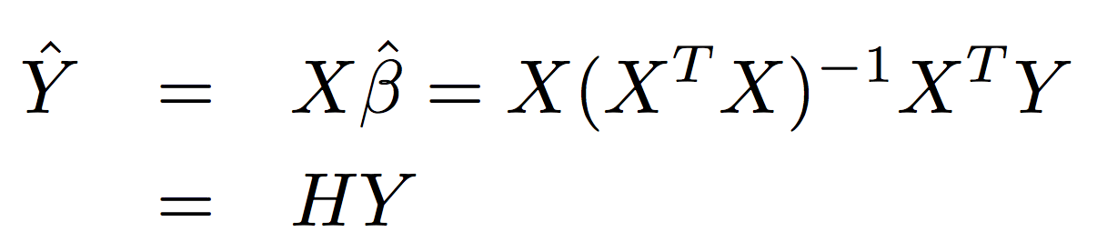
A general analytical solution
With squared-error loss the solution has a closed-form
“Hat matrix”

Slide 24
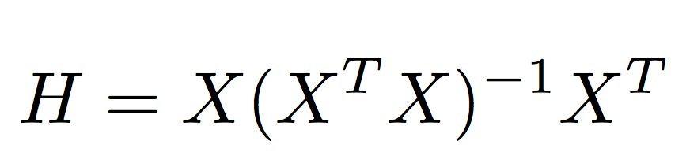
The hat matrix

Slide 25
The hat matrix
X^T
=
X^TX
≈
Σ
X

Slide 26
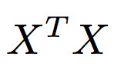
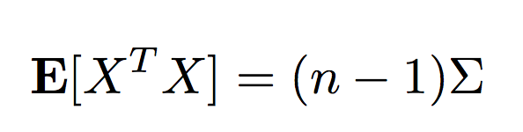
The hat matrix
must not be singular or too close to singular (collinearity)
This assumes you have more observations that features (n > p)
Uses information about relationships between features
i is not inverted in practice (better numerical strategies like a QR decomposition are used)
(optional): Connections to degrees of freedom and prediction error

Slide 27
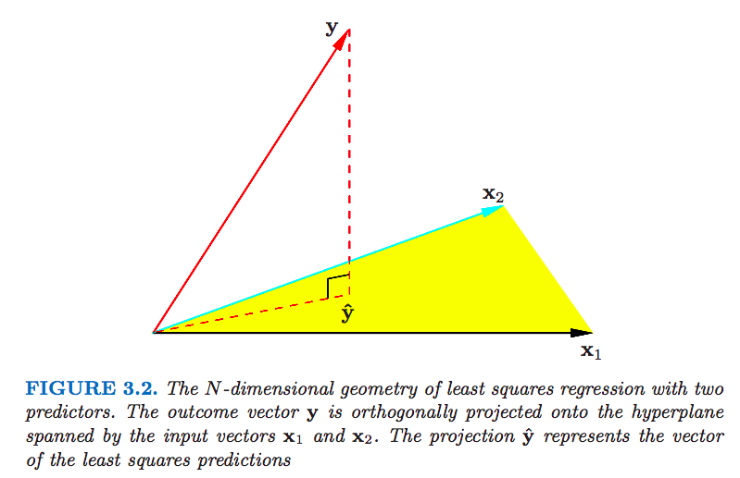
Linear regression as projection
data
span of features
prediction
[ESL]

Slide 28
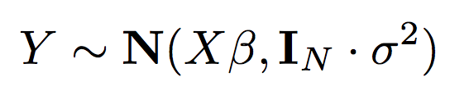
Inference
The linearity of the estimator makes inference easy

Slide 29
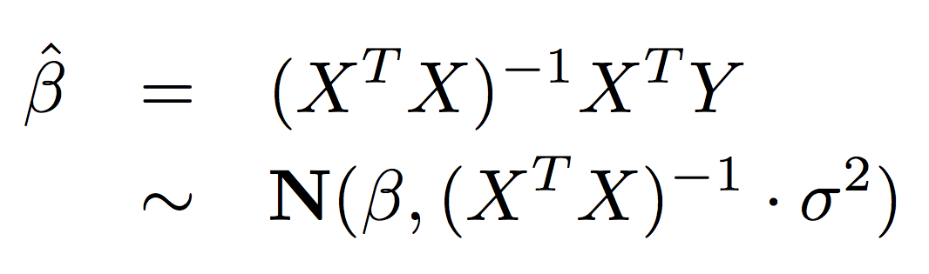
Inference
The linearity of the estimator makes inference easy
usually have to estimate noise level
So that
unbiased
known sample covariance

Slide 30
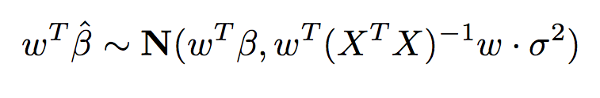
Linear hypotheses
Inference is particularly easy for linear combinations of coefficients
scalar

Slide 31
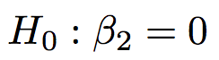
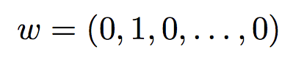
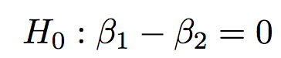
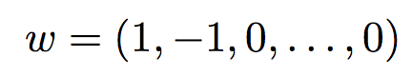
Linear hypotheses
Inference is particularly easy for linear combinations of coefficients
Individual coefficients
Differences
scalar

Slide 32
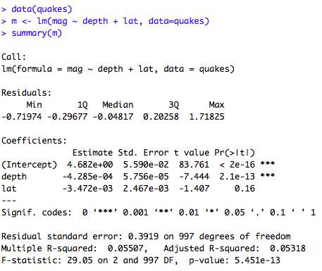
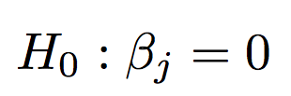
Inference for single parameters
We can then test for the presence of a single variable
caution! this tests a single variable
but correlation with other variables
can make it confusing

Slide 33
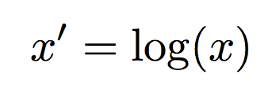
Feature engineering
The predictor is linear in the features, not necessarily the data
Example: simple transformations

Slide 34
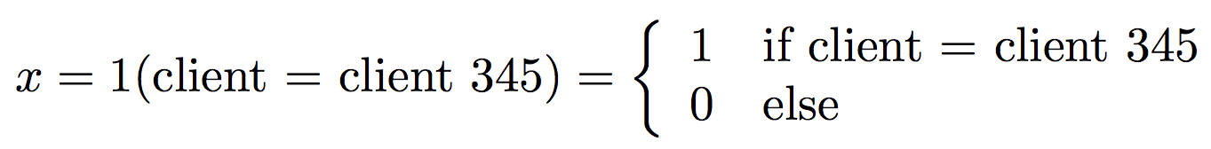
Feature engineering
The predictor is linear in the features, not necessarily the data
Example: dummy variables

Slide 35
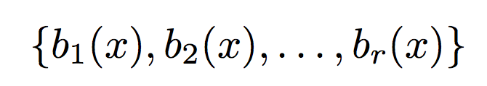
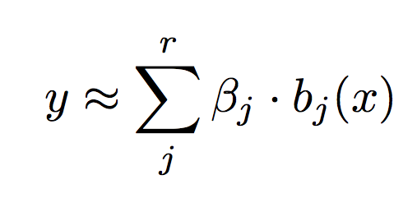
Feature engineering
The predictor is linear in the features, not necessarily the data
Example: basis expansions (FFT, wavelets, splines)

Slide 36
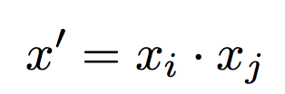
Feature engineering
The predictor is linear in the features, not necessarily the data
Example: interactions

Slide 37
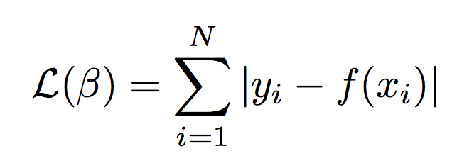
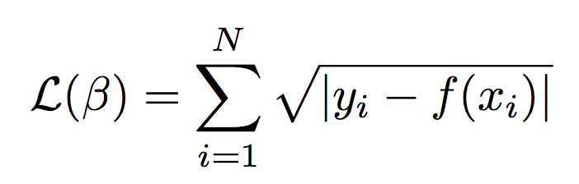
Why squared error loss?
Why use squared error loss
instead of something else?
or

Slide 38
Why squared error loss?
Why use squared error loss?
Math on quadratic functions is easy (nice geometry and closed-form solution)
Estimator is unbiased
Maximum likelihood
Gauss-Markov
Historical precedent

Slide 39
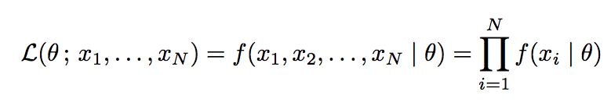
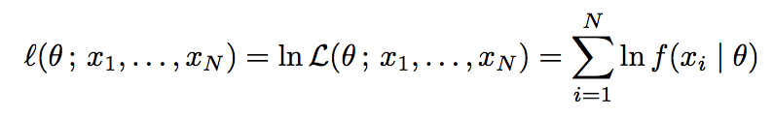
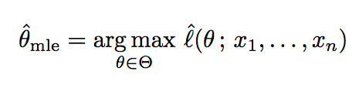
Maximum likelihood
Maximum likelihood is a general estimation strategy
joint density
Likelihood function
Log-likelihood
MLE
[wikipedia]

Slide 40
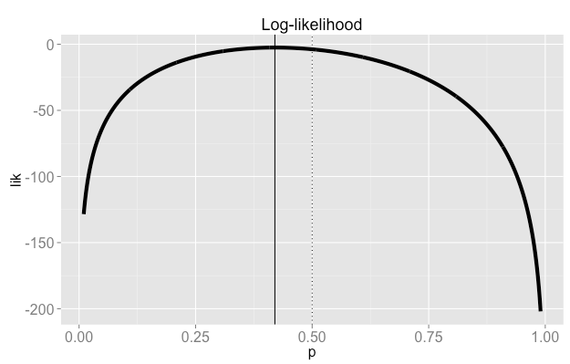
Maximum likelihood
Example: 42 out 100 heads from a fair coin
true value
sample
maximum

Slide 41
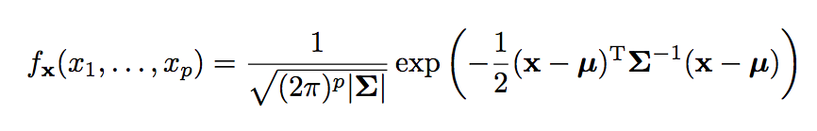
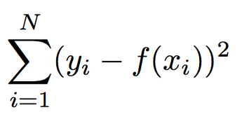
Why least squares?
For linear regression, the likelihood involves the density of the multivariate normal
After taking the log and simplifying we arrive at (something proportional to) squared error loss
[wikipedia]

Slide 42
MLE for linear regression
There are many theoretical reasons for using the MLE
The estimator is consistent (will converge to the true parameter in probability)
The asymptotic distribution is normal, making inference easy if you have enough data
The estimator is efficient: the asymptotic variance is known and achieves the Cramer-Rao theoretical lower bound
But are we relying too much on the assumption that the errors are normal?

Slide 43
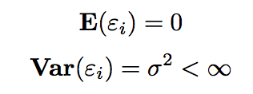
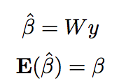
The Gauss-Markov theorem
Suppose that
(no assumption of normality)
Then consider all unbiased, linear estimators such that for some matrix W
Gauss-Markov: linear regression has the lowest MSE for any β.
(“BLUE”: best linear unbiased estimator)
[wikipedia]

Slide 44
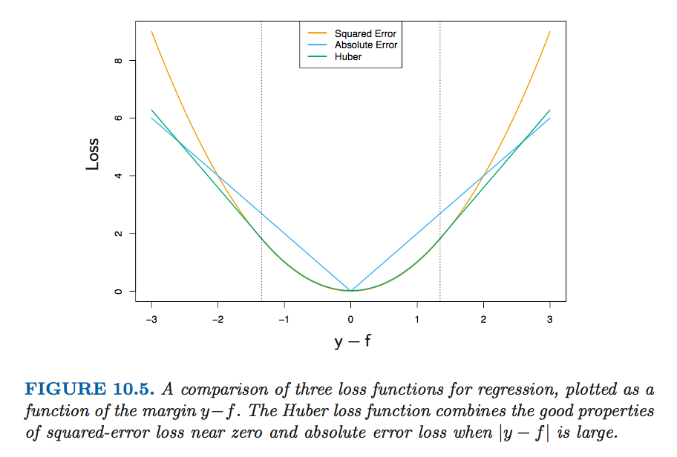
Why not to use squared error loss
Squared error loss is sensitivity to outliers. More robust alternatives: absolute loss, Huber loss
[ESL]

Slide 45
Part II: Generalized linear models

Slide 46
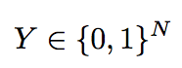
Binary data
The linear model no longer makes sense as a generative model for binary data
… but
However, it can still be very useful as a predictive model.

Slide 47
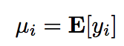
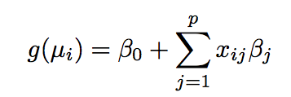
Generalized linear models
To model binary outcomes: model the mean of the response given the data
link function

Slide 48
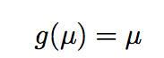
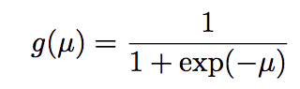
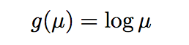
Example link functions
Linear regression
Logistic regression
Poisson regression
For more reading: The choice of the link function is related to the natural parameter of an exponential family

Slide 49
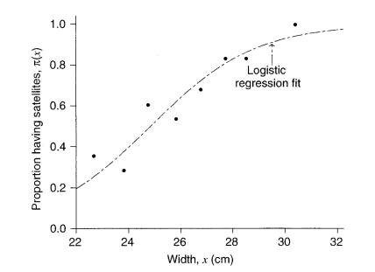
Logistic regression
Sample data: empirical proportions as a function of the predictor
[Agresti]

Slide 50
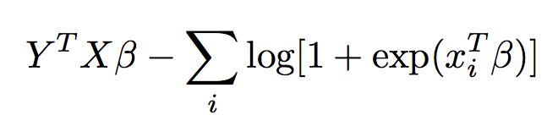
Choosing β
Choosing β: maximum likelihood!
Optimality properties of the MLE still apply.
Key property: problem is convex! Easy to solve with Newton-Raphson or any convex solver

Slide 51
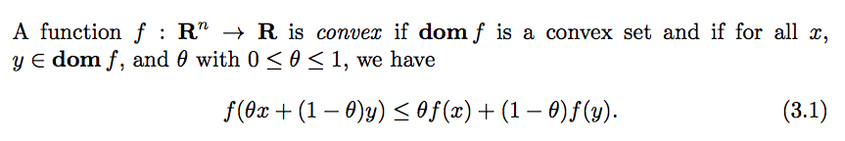
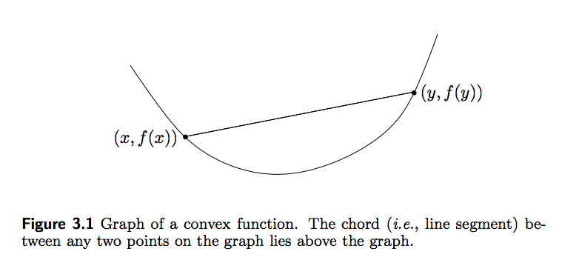
Convex functions
[Boyd]

Slide 52
Part III: Regularization

Slide 53
Regularization
Regularization is a strategy for introducing bias.
This is usually done in service of
incorporating prior information
avoiding overfitting
improving predictions

Slide 54
Part III: Regularization
Ridge regression

Slide 55

Ridge regression
Add a penalty to the least-squares loss function
This will “shrink” the coefficients towards zero

Slide 56

Ridge regression
Add a penalty to the least-squares loss function
penalty weight; tuning parameter
An old idea: Tikhonov regularization

Slide 57

Ridge regression
Add a penalty to the least-squares loss function
Still linear, but changes the hat matrix by adding a “ridge” to the sample covariance matrix
closer to diagonal - puts less faith in sample correlations

Slide 58



Correlated features
Ridge regression will tend to spread weight across correlated features
Toy example: two perfectly correlated features (and no noise)

Slide 59


Correlated features
To minimize L2 norm among all convex combinations of x1 and x2
the solution is to put equal weight on each feature

Slide 60
Ridge regression
Good advice in life:
Don’t underestimate ridge regression!

Slide 61
Part III: Regularization
Bias and variance

Slide 62

The bias-variance tradeoff
The expected prediction error (MSE) can be decomposed
[ESL]

Slide 63

The bias-variance tradeoff
[ESL]

Slide 64
Part III: Regularization
James-Stein

Slide 65


Historical connection: The James-Stein estimator
Shrinkage is a powerful idea found in many statistical applications.
In the 1950’s Charles Stein shocked the statistical world with (a version of) the following result.
Let μ be a fixed, arbitrary p-vector and suppose we observe one observation of y
The MLE for μ is just the observed vector
[Efron]

Slide 66

The James-Stein estimator
The James-Stein estimator pulls the observation toward the origin
shrinkage
[Efron]

Slide 67

The James-Stein estimator
Theorem: For p >=3, the JS estimator dominates the MLE for any μ!
Shrinking is always better.
The amount of shrinkage depends on all elements of y, even though the elements of μ don’t necessarily have anything to do with each other and the noise is independent!
[Efron]

Slide 68



An empirical Bayes interpretation
Put a prior on μ
Then the posterior mean is
This is JS with the unbiased estimate
[Efron]

Slide 69
James-Stein
The surprise is that JS is always better, even without the prior assumption
[Efron]

Slide 70
Part III: Regularization
LASSO

Slide 71

LASSO

Slide 72


LASSO
Superficially similar to ridge regression, but with a different penalty
Called “L1” regularization

Slide 73
L1 regularization
Why L1?
Sparsity!
For some choices of the penalty parameter L1 regularization will cause many coefficients to be exactly zero.

Slide 74


L1 regularization
The LASSO can be defined as a closely related to the constrained optimization problem
which is equivalent* to minimizing (Lagrange)
for some λ depending on c.

Slide 75

LASSO: geometric intuition
[ESL]

Slide 76

L1 regularization

Slide 77

Bayesian interpretation
Both ridge regression and the LASSO have a simple Bayesian interpretation

Slide 78

Maximum a posteriori (MAP)
Up to some constants
model likelihood
prior likelihood

Slide 79


Maximum a posteriori (MAP)
Ridge regression is the MAP estimator (posterior mode) for the model
For L1: Laplace distribution instead of normal

Slide 80

Compressed sensing
L1 regularization has deeper optimality properties.
Slide from Olga V. Holtz: http://www.eecs.berkeley.edu/~oholtz/Talks/CS.pdf

Slide 81

Basis pursuit
Slide from Olga V. Holtz: http://www.eecs.berkeley.edu/~oholtz/Talks/CS.pdf

Slide 82

Equivalence of problems
Slide from Olga V. Holtz: http://www.eecs.berkeley.edu/~oholtz/Talks/CS.pdf

Slide 83

Compressed sensing
Many random matrices have similar incoherence properties - in those cases the LASSO gets it exactly right with only mild assumptions
Near-ideal model selection by L1 minimization [Candes et al, 2007]

Slide 84

Betting on sparsity
When you have many more predictors than observations it can pay to bet on sparsity
[ESL]

Slide 85
Part III: Regularization
Elastic-net

Slide 86

Elastic-net
The Elastic-net blends the L1 and L2 norms with a convex combination
tuning parameters
It enjoys some properties of both L1 and L2 regularization
estimated coefficients can be sparse
coefficients of correlated features are pulled together
still nice and convex

Slide 87

Elastic-net
The Elastic-net blends the L1 and L2 norms with a convex combination
[ESL]

Slide 88
Part III: Regularization
Grouped LASSO

Slide 89

Grouped LASSO
Regularize for sparsity over groups of coefficients
[ESL]

Slide 90
Grouped LASSO
Regularize for sparsity over groups of coefficients - tends to set entire groups of coefficients to zero. “LASSO for groups”
design matrix for group l
coefficient vector for group l
L2 norm not squared
[ESL]

Slide 91
Part III: Regularization
Choosing regularization parameters

Slide 92

Choosing regularization parameters
The practitioner must choose the penalty. How can you actually do this?
One simple approach is cross-validation
[ESL]

Slide 93

Choosing regularization parameters
Choosing an optimal regularization parameter from a cross-validation curve
model
complexity
[ESL]

Slide 94
Choosing regularization parameters
Choosing an optimal regularization parameter from a cross-validation curve
Warning: this can easily get out of hand with a grid search over multiple tuning parameters!
[ESL]

Slide 95
Part IV: Extensions

Slide 96
Part IV: Extensions
Weights

Slide 97

Adding weights
It is easy to add weights to most linear models
weights

Slide 98


Adding weights
This is related to generalized least squares for more general error models
Leads to

Slide 99
Part IV: Extensions
Constraints

Slide 100

Non-negative least squares
Non-negative coefficients - still convex

Slide 101

Structured constraints: Isotonic regression
Monotonicity in coefficients
for i >= j
[wikipedia]

Slide 102

Structured constraints: Isotonic regression
[wikipedia]

Slide 103
Part IV: Extensions
Generalized additive models

Slide 104

Generalized additive models
Move from linear combinations

Slide 105

Generalized additive models
Sum of functions of your features

Slide 106

Generalized additive models
[ESL]

Slide 107

Generalized additive models
Extremely flexible algorithm for a wide class of smoothers: splines, kernels, local regressions...
[ESL]

Slide 108
Part IV: Extensions
Support vector machines

Slide 109

Support vector machines
Maximum margin classification
[ESL]

Slide 110

Support vector machines
Can be recast a regularized regression problem
[ESL]

Slide 111

Support vector machines
The hinge loss function
[ESL]

Slide 112

SVM kernels
Like any regression, SVM can be used with a basis expansion of features
[ESL]

Slide 113

SVM kernels
“Kernel trick”: it turns out you don’t have to specify the transformations, just a kernel
Basis transformation is implicit
[ESL]

Slide 114

SVM kernels
Popular kernels for adding non-linearity

Slide 115
Part IV: Extensions
Mixed effects

Slide 116

Mixed effects models
Add an extra term to the linear model

Slide 117

Mixed effects models
Add an extra term to the model
independent noise
another design matrix
random vector

Slide 118



Motivating example: dummy variables
Indicator variables for individuals in a logistic model
Priors:

Slide 119
Motivating example: dummy variables
Indicator variables for individuals in a logistic model
Priors:
deltas from baseline

Slide 120

L2 regularization
MAP estimation leads to minimizing

Slide 121
How to choose the prior variances?
Selecting variances is equivalent to choosing a regularization parameter. Some reasonable choices:
Go full Bayes: put priors on the variances and sample
Use a cross-validation and a grid search
Empirical Bayes: estimate the variances from the data
Empirical Bayes (REML): you integrate out random effects and do maximum likelihood for variances. Hard but automatic!

Slide 122

Interactions
More ambitious: add an interaction
But, what about small sample sizes?

Slide 123
Interactions
More ambitious: add an interaction
But, what about small sample sizes?
delta from baseline and main effects

Slide 124



Multilevel shrinkage
Penalties will strike a balance between two models of very different complexities
Very little data, tight priors: constant model
Infinite data: separate constant for each pair
In practice: somewhere in between. Jointly shrink to global constant and main effects

Slide 125
Partial pooling
“Learning from the experience of others” (Brad Efron)
baseline
only what is needed
beyond the baseline
(penalized)
only what is needed
beyond the baseline and main effects
(penalized)

Slide 126
Mixed effects
Model is very general - extends to random slopes and more interesting covariance structures
independent noise
another design matrix
random vector

Slide 127

Bayesian perspective on multilevel models (great reference)

Slide 128



Some excellent references
[ESL]
[Agresti]
[Boyd]
[Efron]

Slide 129
Thanks!
Questions?
brad@stitchfix.com

